Slide 1






















Slide 3
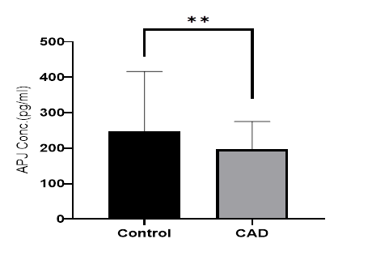

Slide 4
Plasma APJ Levels and Associations
The mean plasma APJ level was significantly lower in the CAD group (197.19 ± 78.06 pg/mL) compared to the control group (248.19 ± 168.15 pg/mL) (p = 0.0046) (Figure 1). There were no statistically significant differences in plasma APJ levels between male and female subjects within either the CAD (p = 0.0978) or control (p = 0.937) groups (Table S1).

Slide 6
-1860 T>C
Plasma Apelin Concentrations and Coronary Artery Disease
Our investigation revealed a significant disparity in plasma apelin levels between patients diagnosed with CAD and healthy controls. Specifically, the mean plasma apelin concentration was substantial-ly lower in the CAD group (2737.81±1205.01 pg/ml) compared to the control group (4258.73±2119.12 pg/ml), with a highly statistically significant difference (p < 0.001) (Figure 1). This finding suggests a potential correlation between apelin levels and CAD risk.

Slide 7
-1860 T>C
In CAD patients, plasma apelin levels were slightly lower in individuals with the TC genotype (2475.0043 ± 1198.9584 pg/ml) compared to those with the TT genotype (2924.4346 ± 1199.7558 pg/ml), although this difference did not reach statistical significance (p > 0.05) (Figure 4). Similarly, no significant differences in plasma apelin levels were observed among control individuals with different genotypes (p > 0.05).
Notably, a statistically significant difference in plasma apelin levels was observed between carriers of the C allele and those carrying the T allele in CAD patients (1939.1939 ± 987.8905 pg/ml vs 2867.0361 ± 1184.9195 pg/ml, respectively, p = 0.002).
This disparity was not observed in control individuals, where plasma apelin levels were comparable between T and C allele carriers.

Slide 8
تصحيح أخطاء املائية في GRAPHICAL ABSTRACT بالجدول لا يوجد نمط CC...CAD patients، Cassociation
genotypes | Control (n=67) | CAD (n=23) | P | OR CI (95%)
TT | 60 (89.6%) | 60 (89.6%) | 0.041 | 3.75 (1.15-12.25)
TC | 7 (30.5%) | 7 (10.5%)
CC | 0 (0%) | 0 (0%)
OR: CI (95%) | P-value | CAD (n=108) | Non-CAD (n=114) | -1860T>C Alleles
3.044 [1.32- 7.01] | 0.007 | 113 (86.3%) | 172 (95%) | T
 |  | 18 (13.7%) | 9 (5%) | C

